Slide 1

AI-Driven Weed Classification and Advisory System Using Deep Learning and RAG-Based Chatbot
Project Review Batch No :16
Presented By:
Mangaraju Surya Rohith : 22765A4203
Manukonda Dinesh : 21761A4235
Chippala Prem Chand : 21761A4214
Shaik Jani Basha : 22765A4205
Under Guidance of :
Dr.B.Rajendhra prasadh sir
DEPARTMENT OF COMPUTER SCIENCE & ENGINEERING (AI&ML)
LAKIREDDY BALI REDDY COLLEGE OF ENGINEERING
(AUTONOMOUS)
L.B.Reddy Nagar :: Mylavaram – 521 230 :: NTR Dist.:: A.P.

Slide 2
Contents
Abstract
Objectives
Scope
Problem Statement
Basic Concepts
Literature Survey
Draw Backs in Existing System
Proposed System
Methodology
Algorithm
Dataset
Implementation
Results
Conclusion
Future work
References
Details of Journal paper

Slide 3
Abstract
Our project develops a Weed Detection System that classifies weed species from an uploaded image using deep learning.
It employs transfer learning with pre-trained models like Inception, Xception, VGG16, and VGG19, integrating custom layers for improved accuracy.
A Generative AI-based RAG chatbot is included to assist farmers with weed-related queries, preventive measures, herbicide recommendations, and proper usage guidelines.
The RAG model-powered chatbot retrieves the most relevant and up-to-date information from a curated knowledge base, ensuring accurate and context-aware responses.

Slide 4
Objective of the Project
Weed Species Classification: To develop a deep learning-based model that can accurately identify and classify different weed species from an uploaded image, aiding farmers in effective weed management.
Transfer Learning Implementation: To use pre-trained models like Inception, Xception, VGG16, and VGG19 and enhance their performance by adding custom CNN layers, resulting in improved accuracy for weed detection.
Optimization of Model Performance: To explore the impact of adding CNN, LSTM, and LRCN layers, leading to the development of a high-accuracy model (96%) for detecting weeds in agricultural images.
Generative AI-Based RAG Chatbot Integration: To build a Generative AI-powered RAG chatbot that provides farmers with real-time assistance on various topics, including weed identification, preventive measures, herbicide recommendations, and their correct usage.
User-Friendly Interface: To create an intuitive, accessible system that allows farmers, even with limited technical knowledge, to easily upload images, obtain weed detection results, and get relevant agricultural guidance.

Slide 5
Scope of the Project
Weed Detection: The system will support the identification of various weed species from images taken by farmers, making weed management more efficient and precise.
Transfer Learning Implementation: To use pre-trained models like Inception, Xception, VGG16, and VGG19 and enhance their performance by adding custom CNN layers, resulting in improved accuracy for weed detection.
Transfer Learning Models: The project focuses on applying multiple pre-trained deep learning models, followed by customizing them with additional layers to enhance weed detection performance. The solution will be adaptable to future model updates and improvements.
Real-Time Assistance via Chatbot: The chatbot will serve as an interactive, AI-driven assistant capable of answering farmers' queries related to weeds, their control, and the best practices in weed management.
Herbicide Guidance: The system will recommend herbicides specific to the identified weed species and provide information on their correct application, ensuring proper usage and minimizing environmental impact.

Slide 6
Problem Statement
Weeds pose a significant challenge to agricultural productivity by competing with crops for essential resources such as nutrients, water, and sunlight. Traditional weed management techniques, including manual weeding and chemical herbicides, are labor-intensive, time-consuming, and often environmentally harmful. Existing automated weed classification models lack accuracy and adaptability across different field conditions, while advisory systems provide only static, pre-programmed responses.
To address these issues, this project aims to develop an AI-driven Weed Classification and Advisory System using hybrid deep learning models (VGG16, VGG19, DenseNet201, Xception) enhanced with CNN, LSTM, and LRNN layers for improved accuracy in weed identification. Additionally, a Retrieval-Augmented Generation (RAG)-based chatbot will provide real-time insights on the impact of specific weeds, preventive measures, and appropriate herbicide application, thereby assisting farmers in making informed decisions.
This integrated approach enhances precision agriculture by offering real-time weed detection, advisory services, and sustainable weed control strategies, reducing manual efforts and promoting eco-friendly farming practices.

Slide 7
Basic Concepts
1. Transfer Learning
A technique where a pre-trained deep learning model (trained on a large dataset like ImageNet) is adapted to a new task with minimal retraining.
Used in our project with VGG16, VGG19, DenseNet201, and Xception to improve weed classification accuracy.
2. Convolutional Neural Networks (CNNs)
A specialized deep learning model designed for image recognition and classification.
Uses convolutional layers to detect spatial features like edges, textures, and patterns in images.
Our project enhances CNN-based models with additional layers for better classification.
3. Long Short-Term Memory (LSTM)
A type of Recurrent Neural Network (RNN) that can learn sequential dependencies over time.
Used in our project to analyze patterns in weed images, improving classification by considering spatial and temporal features.

Slide 8
Basic Concepts
4. Lightweight Recurrent Neural Networks (LRNNs)
A simplified version of traditional RNNs designed to be more computationally efficient.
Helps in maintaining model efficiency while preserving important sequential information.
5. Retrieval-Augmented Generation (RAG) Model
A combination of retrieval-based and generative AI techniques.
Retrieves relevant information from a knowledge base and generates human-like responses.
Used in our chatbot to provide real-time weed impact analysis, prevention strategies, and herbicide recommendations.

Slide 9
Literature Survey
Title | Author | Year of Publication | Limitations
CNN and LSTM Hybrid Model for Weed Identification | Mahajan, Kumar and Gupta | 2022 | The study by Mahajan et al. (2022) introduces a CNN-LSTM hybrid model for weed identification, but it has some limitations. The model is computationally complex, requiring significant resources for training and inference, making deployment on low-power devices challenging. It is also prone to overfitting, especially with small or imbalanced datasets, affecting generalization. Additionally, achieving real-time weed detection may be difficult without high-performance hardware and extensive labeled datasets.
Deep Learning Approaches for Weed Detection in Grasslands: A CNN-Based Approach | Mortensen | 2021 | The study by Mortensen et al. (2021) presents a CNN-based approach for weed detection in grasslands but has limitations. It requires high computational resources, making deployment in low-power agricultural settings difficult. The model also depends on large, high-quality labeled datasets, which are labor-intensive to collect. Additionally, variations in lighting, weed growth stages, and similarities between weeds and crops affect accuracy and generalization. Addressing these issues requires optimized architectures, data augmentation, and diverse datasets for better real-world performance.

Slide 10
Literature Survey
Title | Author | Year of Publication | Limitations
A Survey of Deep Learning Techniques for Weed Detection from Images | Mahmudul Hasan, F. Sohel, D. Diepeveen, H. Laga, and M. G. K. Jones | 2021 | The paper discusses individual deep learning techniques but does not integrate multiple models. Your project combines CNNs, LSTM, and LRNN, improving classification performance. The paper does not provide a system for helping farmers make decisions. Your project includes a RAG-based chatbot, which gives real-time weed impact analysis and management strategies.
Hybrid Deep Learning Model for Weed Identification in Soybean Fields: Combining CNN and SVM Approaches. | Zhang & Wang, | 2022 | The study by Lu et al. (2022) presents a hybrid deep learning model combining Convolutional Neural Networks (CNNs) and Support Vector Machines (SVMs) for weed identification in soybean fields. While this approach enhances classification accuracy, its applicability is limited to soybean crops, and it lacks a real-time advisory component to assist farmers with immediate weed management decisions. Additionally, integrating CNNs with SVMs can introduce complexity in model training and deployment, potentially increasing computational requirements and implementation challenges.

Slide 11
Drawbacks in Existing Systems
Custom CNN-based models and transfer learning often result in limited accuracy due to fewer layers and inadequate fine-tuning
Existing systems fail to capture temporal features, missing important patterns related to weed growth over time.
Shallow model architectures lack the depth needed to effectively identify complex weed species, reducing performance.
Many systems focus only on weed detection, neglecting comprehensive solutions like herbicide recommendations or management strategies.

Slide 12
Proposed System
Hybrid Deep Learning Model for Weed Classification
Uses VGG16, VGG19, DenseNet201, and Xception as base feature extractors.
Enhances classification by adding CNN, LSTM, and LRNN layers for improved accuracy.
Advanced Data Preprocessing & Augmentation
Standardizes image sizes, removes noise, and normalizes pixel values.
Applies rotation, flipping, contrast adjustments, and noise addition to improve generalization.
RAG-Based Chatbot for Weed Management
Uses Retrieval-Augmented Generation (RAG) to provide real-time advisory.
Offers weed impact analysis, prevention strategies, and herbicide recommendations.
Web-Based Deployment for Farmer Accessibility
Built using Flask, allowing users to upload images for instant weed classification.
Provides real-time chatbot responses, making the system easy to use in agricultural settings.

Slide 13
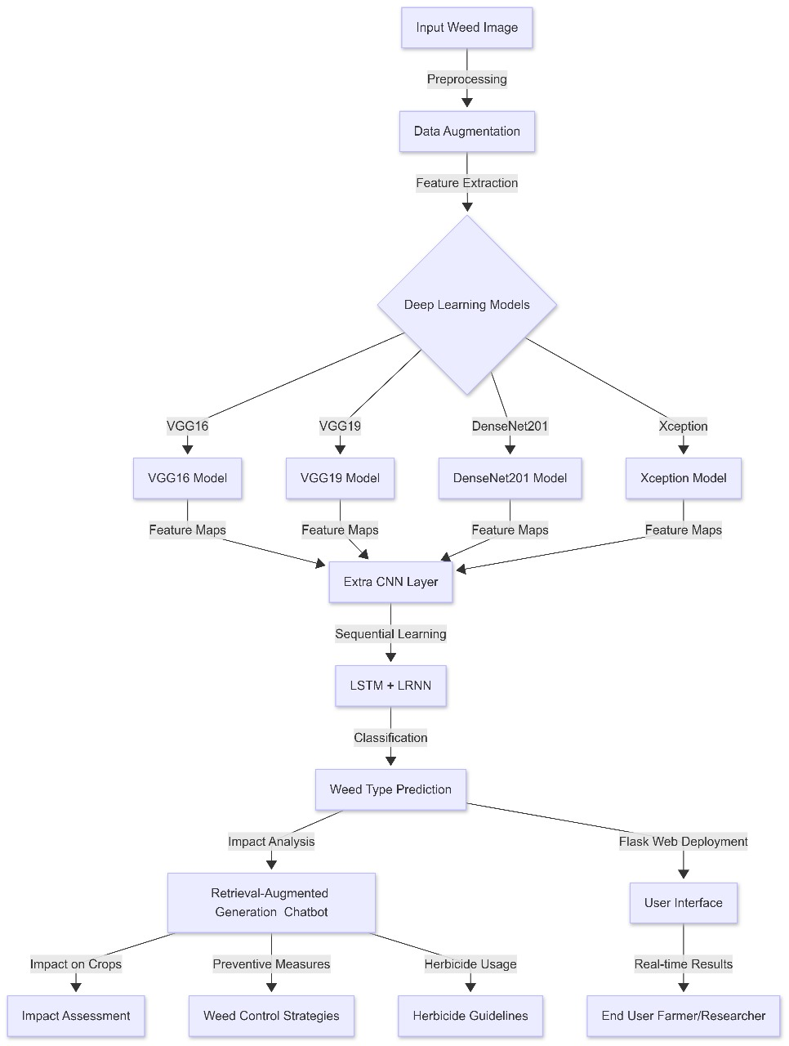
Methodology

Slide 14
Algorithm
Convolutional Neural Network (CNN)
A deep learning model designed for image processing and classification.
Uses convolutional layers to extract spatial features like edges, textures, and patterns.
Example: VGG16, VGG19, DenseNet, and Xception are CNN architectures used in your project.
Long Short-Term Memory (LSTM)
A type of Recurrent Neural Network (RNN) that specializes in learning sequential dependencies.
Helps in analyzing patterns over time, making it useful for temporal feature extraction in image sequences.
Used in your project to enhance weed classification by learning relationships between image features.
Long-term Recurrent Convolutional Network (LRCN)
A hybrid model that combines CNNs (for spatial feature extraction) with LSTMs (for sequential learning).
Effective for video analysis, time-series data, and agricultural monitoring applications.
Your project uses a similar CNN-LSTM approach, but LRCN is more commonly applied in motion-based classification.

Slide 15
Implementation
1. Data Preprocessing and Augmentation
The first step involves preparing the dataset to improve model performance and generalization.
1.1 Dataset Composition
The dataset contains images of weeds and crops along with labeled annotations.
Images are collected under different environmental conditions to ensure robustness.
1.2 Preprocessing Steps
Resizing – Standardizing all images to a fixed size for uniform input.
Normalization – Scaling pixel values between 0 and 1 to stabilize training.
Noise Reduction – Removing distortions to enhance clarity.
1.3 Data Augmentation
To improve model generalization, various transformations are applied:
Rotation and Flipping – Mimics different orientations in the field.
Contrast Adjustment – Ensures visibility under different lighting conditions.
Random Noise Addition – Helps the model learn robust features.

Slide 16
Implementation
2. Deep Learning-Based Weed Classification
A hybrid deep learning approach is used for weed classification, leveraging pre-trained CNN models along with sequential learning.
2.1 Feature Extraction using Pre-trained CNN Models
Four pre-trained CNN architectures are utilized for extracting deep features:
VGG16 & VGG19 – Lightweight CNN models optimized for feature extraction.
DenseNet201 – Uses dense connections to improve gradient flow and avoid overfitting.
Xception – Employs depthwise separable convolutions for efficient learning.
2.2 Enhancing Classification with Additional Layers
After feature extraction, additional layers are added to enhance performance:
Additional CNN Layer – Further refines spatial feature extraction.
Long Short-Term Memory (LSTM) – Captures sequential dependencies in image patterns.
Lightweight Recurrent Neural Network (LRNN) – Helps in identifying long-range dependencies while being computationally efficient.
2.3 Model Training and Optimization
Loss Function: Categorical Cross-Entropy for multi-class classification.
Optimizer: Adam Optimizer for faster convergence.
Metrics Used: Accuracy, Precision, Recall, and F1-score.

Slide 17
Implementation
3. RAG-Based Chatbot for Weed Management
To assist farmers, a Retrieval-Augmented Generation (RAG)-based chatbot is developed for real-time advisory services.
3.1 Knowledge Retrieval Mechanism
The chatbot retrieves domain-specific knowledge about weeds, herbicides, and management techniques.
It pulls relevant information from a precompiled agricultural knowledge base.
3.2 Generative Response Mechanism
Based on user queries, the model generates contextual responses to:
Explain the impact of identified weeds on crops.
Suggest preventive measures to control weed growth.
Provide guidance on herbicide selection and application.

Slide 18
Dataset
Dataset name : DeepWeeds
The DeepWeeds dataset consists of 17,509 unique 256x256 color images in 9 classes. There are 15,007 training images and 2,501 test images. These images were collected in situ from eight rangeland environments across northern Australia.
The selected weed species are local to pastoral grasslands across the state of Queensland. They include: "Chinee apple", "Snake weed", "Lantana", "Prickly acacia", "Siam weed", "Parthenium", "Rubber vine" and "Parkinsonia". The images were collected from weed infestations at the following sites across Queensland: "Black River", "Charters Towers", "Cluden", "Douglas", "Hervey Range", "Kelso", "McKinlay" and "Paluma". The table and figure below break down the dataset by weed, location and geographical distribution.

Slide 19
Results
Model | Accuracy (%) | Precision (%) | Recall (%) | F1-score (%)
VGG16 | 92.1 | 90.8 | 91.2 | 91.0
VGG19 | 92.7 | 91.3 | 91.8 | 91.5
DenseNet201 | 94.2 | 92.6 | 93.1 | 92.8
Xception | 94.9 | 93.5 | 94.0 | 93.7
Proposed Model (CNN+LSTM+LRNN) | 96.8 | 94.5 | 95.2 | 94.8

Slide 20
Conclusion
The study presented the designs of weed classification using theological deep learning models like VGG16, VGG19, DenseNet201, and Xception, enhanced with CNN, LSTM, and LRNN layers. The developed model is remarkable in that it can accurately classify weeds and, hence, help in precision agriculture by reducing the demand for manual labor. The integration of temporal learning through LSTM coupled with feature extraction through CNN has made it possible to increase the classification performance for various weed species by effective detection. In addition, a Retrieval-Augmented Generation (RAG) based chatbot was developed to offer real-time insights regarding the effect of weeds, prevention measures, and appropriate herbicide usage to farmers. It acts as a decision-support tool to help agricultural practitioners reduce crop damage and enhance field productivity. If results are seen, several significant improvements in classification accuracy and applicability in the real world together give this system a feasible select to take into account regarding automated weed management. The enhancements could target an increase in dataset diversity, real-time implementation through edge computing, and further improvement of chatbot capabilities with multilingual support. This will shape a scalable, data oriented, and AI-supported smart farming solution.

Slide 21
Future Work
1. Expanding Dataset Diversity – Incorporating more weed species and images from various agricultural environments will improve model generalization and robustness.
2. Integration with IoT and Edge Computing – Deploying the model on IoT-enabled smart farming devices or edge computing platforms can enable real-time weed detection in fields with minimal latency.
3. Enhancing RAG Chatbot Capabilities – Improving the Retrieval-Augmented Generation (RAG)-based chatbot with multilingual support and voice-enabled interaction will make it more accessible to farmers globally.
4. Multi-Modal Data Fusion – Combining spectral imaging, thermal sensing, and drone-based data can further enhance weed classification accuracy beyond traditional RGB images.
5. Automated Weed Removal Systems – Integrating the weed detection model with autonomous robotic sprayers or precision herbicide application systems could enable automated weed control, reducing manual labor and chemical usage.
6. Cloud-Based Deployment – Hosting the system on a cloud platform can allow seamless access and scalability, enabling farmers to use it through a mobile or web application.

Slide 22
References
[1] A. S. M. Mahmudul Hasan, F. Sohel, D. Diepeveen, H. Laga, and M. G. K. Jones, "A Survey of Deep Learning Techniques for Weed Detection from Images," Computers and Electronics in Agriculture, vol. 184, p. 106067, 2021.
[2] K. Hu et al., "Deep Learning Techniques for In-Crop Weed Recognition in Large Farmland: A Review," Precision Agriculture, vol. 24, pp. 1–29, 2023.
[3] A. S. M. Mahmudul Hasan et al., "A Survey of Deep Learning Techniques for Weed Detection from Images," arXiv preprint arXiv:2103.01415, 2021.
[4] M. Moazzam and S. Khan, "A Review of Application of Deep Learning for Weeds and Crops Classification in Agriculture," Semantic Scholar, 2021.
[5] Y. Li et al., "Weed25: A Deep Learning Dataset for Weed Identification," Frontiers in Plant Science, vol. 13, p. 1053329, 2022.
[6] K. Hu et al., "Review of Deep Learning-Based Weed Identification in Crop Fields," International Journal of Agricultural and Biological Engineering, vol. 15, no. 1, pp. 1–9, 2022.
[7] A. S. M. Mahmudul Hasan et al., "Weed Recognition Using Deep Learning Techniques on Class-Imbalanced Imagery," arXiv preprint arXiv:2103.03856, 2021.
[8] R. Rakhmatulin, "Neural Networks for Weed Recognition in Agro-Industrial Applications: A Decade of Research," Artificial Intelligence in Agriculture, vol. 5, pp. 75–89, 2023.
[9] Dos Santos Ferreira et al., "Deep Learning-Based Classification of Weeds and Crops in Sugar Beet Fields," Biosystems Engineering, vol. 190, pp. 153–167, 2020.
[10] M. Bah, A. Hafiane, and R. Canals, "Deep Learning Based Weed Detection in Cereal Crops Using U-Net Segmentation Network," Computers and Electronics in Agriculture, vol. 176, p. 105658, 2020.

Slide 23
References
[11] I. Sa et al., "Deep Learning-Based Weed Classification in UAV Imagery," Sensors, vol. 17, no. 5, p. 1085, 2017.
[12] J. Partel, T. K. Khot, and M. S. Whiting, "Real-Time Precision Spraying System Using Deep Learning-Based Weed Detection," Computers and Electronics in Agriculture, vol. 157, pp. 339–350, 2019.
[13] A. Milioto, P. Lottes, and C. Stachniss, "Real-Time Crop and Weed Classification Using Deep Learning-Based Semantic Segmentation," Robotics and Autonomous Systems, vol. 174, p. 103811, 2022.
[14] P. Lottes, J. Behley, A. Milioto, and C. Stachniss, "Fully Convolutional Networks with Multi-Spectral Images for Weed Classification and Crop Monitoring," ISPRS Journal of Photogrammetry and Remote Sensing, vol. 145, pp. 235–246, 2018.
[15] D. A. Mortensen et al., "Deep Learning Approaches for Weed Detection in Grasslands: A CNN-Based Approach," Agricultural Systems, vol. 192, p. 103147, 2021.

Slide 24
Thank Q

